Slide 1
Class-based languages
Rafał Łasocha
ii@UWr, 5.03.2014

Slide 2
Definitions
there are many definitions of class, depends on language
the most popular: classes are describing objects, with specified fields and methods (full code)
attributes = fields + methods
object = instance of class
InstanceTypeOf(foo) = type of class Foo (note that class ≠ type)
Special keyword, self (this), refers to current object
Notes:
Other definitions of classes: abstract classes (without code of methods), classes only with hierarchy.
Our model: classes describe behavior, objects have state.

Slide 3
Real world
Simula 67 – first language with classes, objects, inheritance
Smalltalk
  canonical example of class-based language, influential to many other popular today (c++, obj-c, c#, java, python, ruby...), it's pure oo language
  Implications of the fact, that class is an object
currently, there are huge amount of class-based languages
Notes:
No distinction between primitive values and objects.
Everything is an object, so classes are objects too (classes are instance of Class class).
And since class is an object, it can has it's own methods, called "class methods", "class variables", equivalent to static methods/variables in Java/C++

Slide 4
Smalltalk few examples
3 + 4 → send ’+ 4’ to 3
20 factorial → send factorial to 20
20 factorial class → LargePositiveInteger
Object new class → Object
MyStudent := Customer new
Object subclass: #TrainSet
instanceVariableNames: 'engine cars'
classVariableNames: ' '
poolDictionaries: ' '

Slide 5
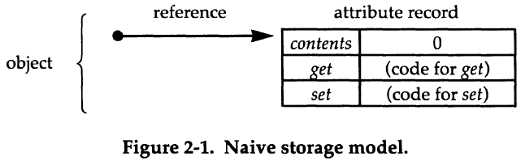
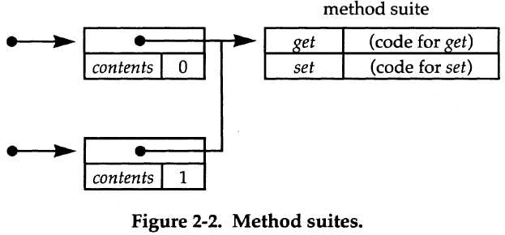
Storage models
naive (attribute record)
records with fields and references to method suites

Slide 6
Method lookup
may be performed during compilation or runtime
method suites organized in trees or directed graphs (multiple inheritance)
method suites assigned to more specific subclasses, delegate calls to its' parents
implementation of lookup should include lookup of class variables
some languages (beta, ruby) allows to assign methods to objects
Example (ruby):
bar = Foo.new
def bar.x
...
end
Notes:
private, protected keywords

Slide 7
Subclasses, inheritance
„c' inherits from c” ⇔ „c' is a subclass of c”
fields from superclass (parent) are present in subclass
methods from superclass are present in subclass, but may be overriden
some languages (simula, c++) allow to override only those methods, which have been declared as virtual
self keyword – refers to a subclass
multiple inheritance – when class can inherit from more than one class (notice that conflicts are possible and super may be tricky)
Notes:
for super, there is no "upward path" to follow in MI

Slide 8
class cell is
var contents: Integer := 0;
method get() : Integer is
return self.contents;
end;
method set(n: Integer) is
self.contents := n;
end;
end;
subclass reCell of cell is
var backup: Integer := 0;
override set(n: Integer) is
self.backup := self.contents;
super.set(n);
end;
method restore() is
self.contents := self.backup;
end;
end;
var myCell : InstanceTypeOf(cell) := new cell;

Slide 9
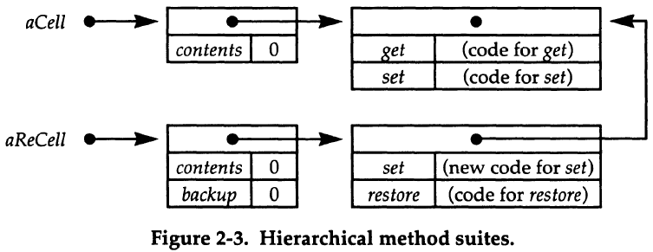
Storage model (with inheritance)

Slide 10
Super keyword
makes possible running original implementation of redefined methods
many different implementations
  super as a „parent self”
  super as a parent method (CLOS: call-next-method)
  none; instead of super keyword, some languages provides syntax to access methods directly from specific class
  instead of specifying where to call parent method, specify where to call subclass' method (inner keyword in Beta), so method extension rather than method overriding
  exists even composition of super and inner, described in (2)
self inside super methods refers to subclass

Slide 11
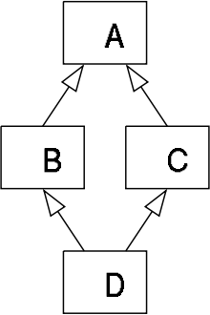
Diamond problem
A implements method foo()
B and C are overriding it
what about (new D).foo() call?
many solutions
  just don't allow this situation
  take implementation from the first language (first - in some order)
  Eiffel-way: provide syntax to solve name conflicts (by renaming and selecting)

Slide 12
Eiffel-way solution
class TEACHING_ASSISTANT inherit
TEACHER
rename
computer_account as faculty_account
select
faculty_account
end
STUDENT
rename
computer_account as student_account
end

Slide 13
Subsumption
subtype polimorphism – If c' is a subclass of c, and o' : InstanceTypeOf(c'), then o' : InstanceTypeOf(c)
subtype relation (partial order): „A <: B”
  If a : A and A <: B, then a : B (subsumption)
  InstanceTypeOf(c') <: InstanceTypeOf(c) iff c' is a subclass of c

Slide 14
Subsumption and method dispatch - examples
var myCell : InstanceTypeOf(cell) := new cell;
var myReCell : InstanceTypeOf(reCell) := new reCell;
procedure f(x : InstanceTypeOf(cell)) is … end;
myCell := myReCell;
f(myReCell);
procedure g(x : InstanceTypeOf(cell)) is
x.set(3);
end;
g(myReCell);

Slide 15
Method dispatch
static dispatch – choosing the method during compilation
dynamic dispatch – choosing the method in run-time
different dispatch may result in different methods selected to call
dynamic dispatch is available in virtually all object-oriented languages
some languages provide both kinds of dispatch
With dynamic dispatch, there is no runtime side-effects of subsumption (think about set() from reCell, after assignment variableOfTypeCell := reCell)

Slide 16
Type information / typecase
during subsumption from reCell to cell, we lost information that instance of reCell have method restore()
typecase – useful feature (Simula, Modula-3), but language shouldn't require to change all related typecases when defining new subclass
typecase x
when rc: InstanceTypeOf(reCell) do … rc.restore() …;
when c: InstanceTypeOf(cell) do …;
end;

Slide 17
Covariance, contravariance, invariance
type operator T is:
  Covariant if A' <: A ⇔ T(A') <: T(A)
  Contravariant if A' <: A ⇔ T(A) <: T(A')
  Invariant if neither of above applies
A×B <: A'×B' if A <: A' and B <: B'
A→B <: A'→B' if A' <: A and B <: B' (function is contravariant in it's argument, and covariant in return type)
mutable structures (mutable pairs, arrays) are invariant
Notes:
functions: PersianCat <: Cat <: Animal <: Thing
mutable: cat[] and animal[]

Slide 18
Method specialization
fields cannot change their types between subclasses (mutable structures are invariant)
methods can be specialized (simple implication from A → B variance)
older versions of Eiffel were supporting covariance of argument (catcall problem)
self is covariantly specialized by inheritance
what about methods of c, which return InstanceTypeOf(c)?
Notes:
class CatShelter extends AnimalShelter {
void putAnimal(Cat animal) {
...
}
}

Slide 19
Self type specialization
class c is
method m(): InstanceTypeOf(c) is
… return self;
end;
end;
subclass c' of c is
end;
// C++
class A
{
public:
A* Hello()
{
return this;
}
}
class B : public class A
{
public:
B* World()
{
return this;
}
}
// b.Hello() returns
// A type
self in c' is InstanceTypeOf(c')
we would like o'.m() to be InstanceTypeOf(c')
solution: introduction of Self type
we could even use Self as type for fields, but it's not always type-safe
class c is
method m(): Self is … return self; end;
end;
class c is
method m(): Self is … return self; end;
end;

Slide 20
Object types
until now, types were almost the same as classes
introduction of object types (interfaces-like), which are independent from implementations (classes)
on example with cells: ObjectTypeOf(cell) = Cell
notice, that different classes may have the same ObjectType
object protocol – type signature of the object
ObjectType Cell is
var contents : Int;
method get() : Int;
method set(n : Int);
end;
ObjectType ReCell is
var contents : Int;
var backup : Int;
method get() : Int;
method set(n : Int);
method restore();
end;

Slide 21
Subclassing and subtyping
subtyping partial order: „O' <: O if O' has the same components as O and possibly more”
notice, that following is true: „If c' is a subclass of c, then ObjectTypeOf(c') <: ObjectTypeOf(c)”
using the definition on the right and from previous slide, we may conclude that ReCell <: Cell and ReCell <: ReInteger
previously: subclassing-is-subtyping, currently: subclassing-implies-subtyping
ObjectType ReInteger is
var contents : Integer;
var backup : Integer;
method restore();
end;

Slide 22
Method specialization problem
ObjectType Person is
…
method eat( food: Food );
end;
ObjectType Vegetarian is
…
method eat( food: Vegetables );
end;
problem – if Vegetables <: Food, then we can't make Vegetarian a subclass of Person, because we would allow Vegetarian to eat meat (by subsumption)
solution – type parameters
ObjectOperator PersonEating[F <: Food] is
…
method eat( food: F );
end;
ObjectOperator VegetarianEating[F <: Vegetables] is
…
method eat( food: F );
end;
var p : PersonEating[Vegetables];
p := new VegetarianEating[Vegetables];

Slide 23
Method specialization problem
(bounded type parametrization)
// Java
public class Box<T> {
private T t;
public <U extends Number> void inspect(U u){
...
}
}
templates (java)
bounded type specialization supported also by Eiffel

Slide 24
Method specialization problem
(partially abstract types)
ObjectType Person is
type F <: Food;
…
var lunch : F;
method eat( food: F );
end;
ObjectType Vegetarian is
type F <: Vegetables
…
var lunch : F;
method eat( food: F );
end;
by specifying the lunch field, we are specifying F type
however, after specyfing this field, Person/Vegetarian can't eat anything more general

Slide 25
Subclassing without subtyping
inheritance isn't connected with subtyping at all
ObjectType Max is
var n : Integer;
method max(other : Max) : Max;
end;
ObjectType MinMax is
var n : Integer
method max(other: MinMax) : MinMax;
method min(other: MinMax) : MinMax;
end;
class maxClass is
var n : Integer := 0;
method max(other : Self) : Self is
if self.n > other.n then return self else return other end;
end;
end;
subclass minMaxClass of maxClass is
method min(other : Self) : Self is
if self.n < other.n then return self else return other end;
end;
end;

Slide 26
MinMax <: Max ?
subclass minMaxClass' of minMaxClass is
override max(other : Self) : Self is
if other.min(self) = other then return self else return other end;
end;
end;
assumption: MinMax <: Max
mm' : MinMax, then by subsumption mm' : Max, but then, other may be Max, and Max doesn't have min() method

Slide 27
Object protocols
ObjectOperator MaxProtocol[X] is
var n : Integer;
method max(other : X) : X;
end;
ObjectOperator MinMaxProtocol[X] is
var n : Integer
method max(other: X) : X;
method min(other: X) : X;
end;
we can define higher-order subtype relation between type operators:
  P <<: P' iff P[T] <: P'[T] for all types T
notice that MinMax <: MaxProtocol[MinMax]
then, MinMaxProtocol <<: MaxProtocol
for type T, we can always create T-protocol (with Self changed to X)
we can define subprotocol definition between types:
  S subprotocol T if S <: T-Protocol[S]
  S subprotocol T if S-Protocol <<: T-Protocol

Slide 28
Homework
interpreter (only running correct AST, without lexer/parser) for class-based language
language: any, if it will work on 64-bit linux
(Sorry, C#, F# and Visual Basic programmers)
details specified with resources at weekend
deadline: 30.03.2014
classes, inheritance

Slide 29
Sources
„Theory of objects”, Martin Abadi, Luca Cardelli
„Super and Inner — Together at Last!”, David S. Goldberg, Robert Bruce Findler, Matthew Flatt
http://archive.eiffel.com/doc/online/eiffel50/intro/language/tutorial-10.html
http://daimi.au.dk/~beta/Books/betabook.pdf
http://wikipedia.org
http://www.wobblini.net/singletons.html (ruby singletons' methods)
http://pharo.gforge.inria.fr/PBE1/PBE1ch6.html
http://stackoverflow.com/questions/11761506/inheritance-function-that-returns-self-type (c++ example)

